Slide 1
Highway Planning & Design
Lecture - 1
Designed and presented
By
Asst. Prof. Dr. Raquim Nihad Zehawi

Slide 2
FACTORS INFLUENCING HIGHWAY DESIGN
Highway design is based on specified design standards and controls which depend on the following roadway system factors:
• Functional classification
• Design hourly traffic volume and vehicle mix
• Design speed
• Design vehicle
• Cross section elements of the highway
• Social and environmental factors
• Topography of the area
• Level of service
• Available funds
• Safety
• Presence of heavy vehicles on steep grades

Slide 3
These factors are often interrelated. For example, design speed depends on functional classification which is usually related to expected traffic volume.
The design speed may also depend on the topography, particularly in cases where limited funds are available.
In most instances, the principal factors used to determine the standards to which a particular highway will be designed are:
level of service, expected traffic volume, design speed, and the design vehicle.
basic characteristics of the driver, vehicle, and road
are used to determine standards for the geometric characteristics of the highway ??

Slide 4
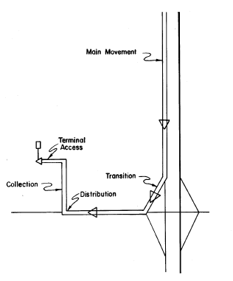
THE CONCEPT OF FUNCTIONAL CLASSIFICATION
Hierarchies of Movements and Components
The six recognizable stages in most trips include
- main movement
- transition
- distribution
- collection
- access
- termination

Slide 5
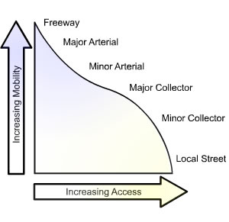

Slide 6
Highway Functional Classification
Highways are classified according to their functions in terms of the service they provide.
Highways and streets are categorized as rural or urban roads, depending on the area in which they are located
urban and rural areas have significantly different characteristics with respect to the type of land use and population density
Within the classification of urban and rural, highways are categorized into the following groups:
Principal arterials
Major collectors
Local roads and streets
Minor arterials
Minor collectors

Slide 7
Urban and Rural Areas
Urban areas are those places having a population of 5,000 or more. These areas are further subdivided into:
urbanized areas (population of 50,000 and over)
small urban areas (population between 5,000 and 50,000)
Rural areas are those areas outside the boundaries of urban areas.
For design purposes, the population forecast for the design year should be used.

Slide 8
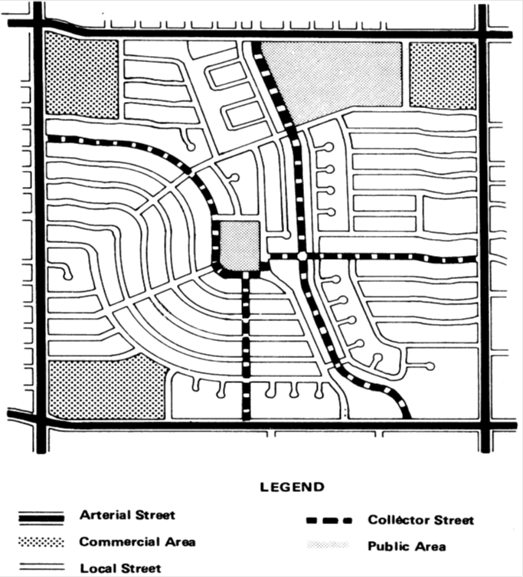
Functional System of Urban Roads

Slide 9
Functional System of Urban Roads
(1) Interstate, with fully-controlled access and grade-separated interchanges;
Urban Principal Arterial System.
(2) Expressways, which have controlled access but may also include at-grade intersections
(3) Principal arterials (with partial or no controlled access).
interconnect with and augment the urban primary arterials
Urban Minor Arterial System.
places more emphasis on land access than the primary arterial system
The spacing is usually not less than 1 mile ,2 or 3.
collect traffic from local streets and convey it to the arterial system
Urban Collector Street System
usually go through residential areas and facilitate traffic circulation
to provide access to abutting land and to the collector streets
Urban Local Street System.
Through traffic is discouraged

Slide 10
Functional System of Rural Roads

Slide 11
Functional System of Rural Roads
1- Freeways (divided highways with fully controlled access and no at-grade intersections)
Rural Principal Arterial System.
2- Principal arterials not classified as freeways
augments the principal arterial system
Rural Minor Arterial System.
connects cities, large towns, and other traffic generators
Travel speeds are high with minimum interference to through movement.
Rural Major Collector System.
carry traffic primarily to and from large cities that are not directly served by the arterial system
routes that collect traffic from local roads and convey it to other facilities
Rural Minor Collector System.
provide linkage between rural hinterland and locally important traffic generators
all roads within the rural area not classified within the other systems
Rural Local Road System.
connect adjacent lands with the collector roads

Slide 12
Highway Functional Classification
Functional System of Urban Roads
Functional System of Rural Roads
1. Urban Principal Arterials
1. Rural Principal Arterials
(1) Interstate
(2) Expressways
(3) Principal arterials
1- Freeways
2- Principal arterials
2. Urban Minor Arterials
2. Rural Minor Arterials
3. Urban Collector Streets
3. Rural Major Collectors
4. Urban Local Streets
4. Rural Minor Collectors
5. Rural Local Roads

